Slide 1




Dr Russell S. Hamilton
Email: rsh46@cam.ac.uk
Twitter: @drrshamilton
Version 0.1: 20160818

Slide 2
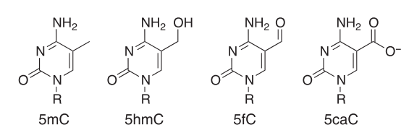
What is Methylation?
cytosine
5’-methyl-C
5’-hydroxymethyl-C
5’-formyl-C
5’carboxy-C
Modifications to cytosine are the most widely studied, however Adenosine also known to be methylated m6A
[Figure adapted from Booth et al., 2013]
Russell S. Hamilton rsh46@cam.ac.uk ::: darogan@gmail.com ::: @drrshamilton 2

Slide 3
What is Methylation?
[Figure from www.diagenode.com]
Russell S. Hamilton rsh46@cam.ac.uk ::: darogan@gmail.com ::: @drrshamilton 3

Slide 4
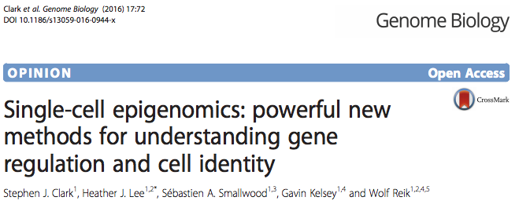
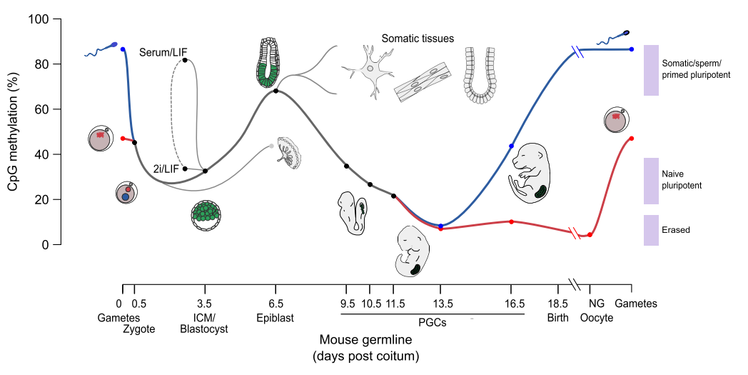
Methylation Function in Development
Russell S. Hamilton rsh46@cam.ac.uk ::: darogan@gmail.com ::: @drrshamilton 4

Slide 5
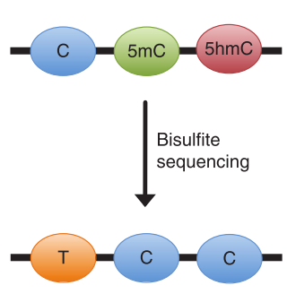
Bisulfite Sequencing (bs or mkbs)
Traditional bisulfite sequencing
Confounded signal 5mC + 5hmC
Russell S. Hamilton rsh46@cam.ac.uk ::: darogan@gmail.com ::: @drrshamilton 5

Slide 6
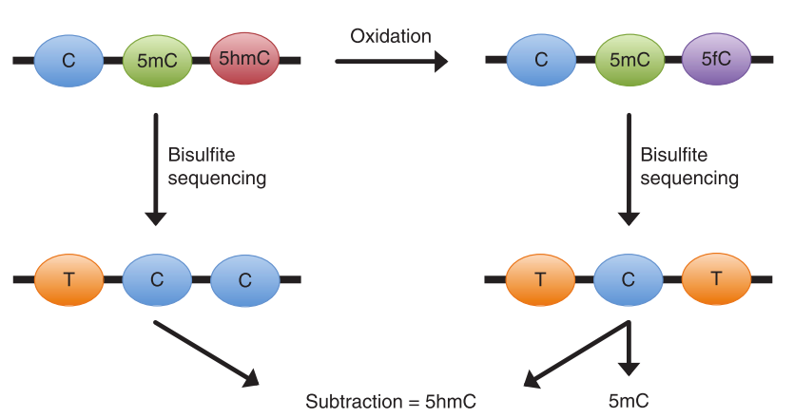
Oxidative bisulfite sequencing (oxbs)
Commercialised by Cambridge Epigenetix (CEGX)
Russell S. Hamilton rsh46@cam.ac.uk ::: darogan@gmail.com ::: @drrshamilton 6

Slide 7
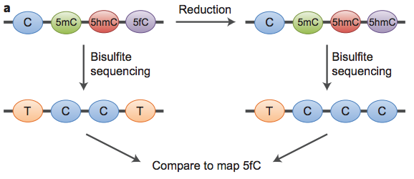
Reductive bisulfite sequencing
Commercialised by Cambridge Epigenetix (CEGX)
Russell S. Hamilton rsh46@cam.ac.uk ::: darogan@gmail.com ::: @drrshamilton 7

Slide 8
TAB-Seq
Commercialised by WiseGene
Russell S. Hamilton rsh46@cam.ac.uk ::: darogan@gmail.com ::: @drrshamilton 8

Slide 9
Assays using bisulfite sequencing
Illumina Array Based
Illumina 450K array
Illumina EPIC (850K) array
Illumina Sequencing Based
Whole Genome Bisulfite Sequencing (WGBS) inc oxbs/redbs
Antibody Pulldown (e.g. (h)MeDIP)
Reduced Representation Bisulfite Sequencing (RRBS)
Targeted Bisulfite Sequencing (e.g. CpGiant)
Enzymatic conversion (TAB-Seq)
PacBio
Direct reading of cytosine methylation
Nanopore
Oxford Nanopore direct reading of cytosine methylation
Current State of the Art
Future State of the Art
Russell S. Hamilton rsh46@cam.ac.uk ::: darogan@gmail.com ::: @drrshamilton 9

Slide 10
Whole Genome Bisulfite Sequencing
Bisulfite Treatment
Sample
Illumina Sequencing
Library Preparation
Bisulfite aware genome aligner
Bismark conservative 80+% best supported
ERNE2 balanced 90+% fast
BWA-Meth leanient 95+% soft-clipping
Russell S. Hamilton rsh46@cam.ac.uk ::: darogan@gmail.com ::: @drrshamilton 10

Slide 11
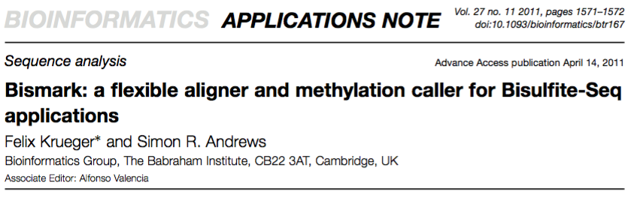
Bismark Aligner
Arguable the most widely used bisulfite aware aligner…
Very well supported (seqanswers.com, GitHub)
Integrates with downstream tools
[Figure from Krueger F & Andrews SR (2011) Bioinformatics. 27(11):1571-2]
Russell S. Hamilton rsh46@cam.ac.uk ::: darogan@gmail.com ::: @drrshamilton 11

Slide 12
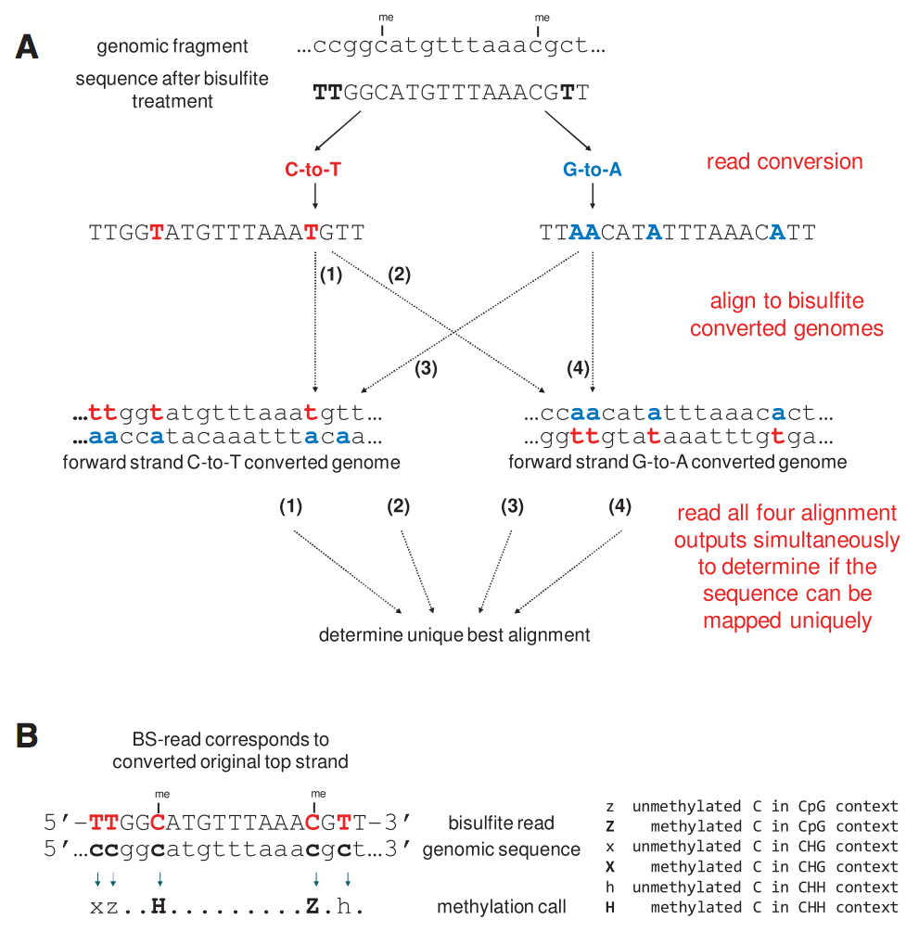
Bismark Aligner
[Figure from Krueger F & Andrews SR (2011) Bioinformatics. 27(11):1571-2]
Russell S. Hamilton rsh46@cam.ac.uk ::: darogan@gmail.com ::: @drrshamilton 12

Slide 13
Bismark Methylation Calling
[Figure from Krueger F & Andrews SR (2011) Bioinformatics. 27(11):1571-2]
Russell S. Hamilton rsh46@cam.ac.uk ::: darogan@gmail.com ::: @drrshamilton 13

Slide 14
Practical Pre-made data
1. Reference Genome Prepared for Bisulfite Alignment
Human Genome ~3Gb disk space
With preparation for bs-seq ~11Gb
Very CPU / Memory intensive…
Selected a random 5Mb region from Chr1
(no N content)
4.9Mb Homo_sapiens.GRCh38.dna.chromosome.1.region30000000-5000000.fa
39Mb Bisulfite_Genome
2. Bisulfite Treated and Sequenced Reads
Typically 30x coverage recommended to achieve accurate single base resolution methylation calls.
Very CPU / Memory intensive…
Simulated a data set using reference region and Sherman
Read1 Read2
mkbs 1M/36Mb 1M/37Mb
oxbs 1M/38Mb 1M/37Mb
Russell S. Hamilton rsh46@cam.ac.uk ::: darogan@gmail.com ::: @drrshamilton 14

Slide 15
Bisulfite Genome Preparation
Reference genome must be prepared for bisulfite alignment
$ bismark_genome_prepare --bowtie2 NGSchool_GRCh38_Chr1_region
├── Homo_sapiens.GRCh38.dna.chromosome.1.region30000000-5000000.fa
├── Bisulfite_Genome
├── CT_conversion
│ ├── BS_CT.1.bt2
│ ├── BS_CT.2.bt2
│ ├── BS_CT.3.bt2
│ ├── BS_CT.4.bt2
│ ├── BS_CT.rev.1.bt2
│ ├── BS_CT.rev.2.bt2
│ └── genome_mfa.CT_conversion.fa
└── GA_conversion
├── BS_GA.1.bt2
├── BS_GA.2.bt2
├── BS_GA.3.bt2
├── BS_GA.4.bt2
├── BS_GA.rev.1.bt2
├── BS_GA.rev.2.bt2
└── genome_mfa.GA_conversion.fa
Russell S. Hamilton rsh46@cam.ac.uk ::: darogan@gmail.com ::: @drrshamilton 15

Slide 16
Simulating Bisulfite Treated Reads
Simulate a set of 1M bisulfite reads to achieve ~30X coverage Chr1:30000000-5000000
$ Sherman \
--length 100 \
--number_of_seqs 1000000 \
--genome_folder NGSchool_GRCh38_Chr1_region/ \
--paired_end \
--minfrag 70 \
--maxfrag 400 \
--conversion_rate 99 \
--error_rate 0.25 \
--variable_length_adapter 100
mv simulated_1.fastq mkbs_sim_1.fastq; gzip mkbs_sim_1.fastq
mv simulated_2.fastq mkbs_sim_2.fastq; gzip mkbs_sim_2.fastq
Simulate a set of 1M oxidative bisulfite reads
As above, but with
--conversion_rate 90
mv simulated_1.fastq oxbs_sim_1.fastq; gzip oxbs_sim_1.fastq
mv simulated_2.fastq oxbs_sim_2.fastq; gzip oxbs_sim_2.fastq
http://www.bioinformatics.babraham.ac.uk/projects/sherman
Russell S. Hamilton rsh46@cam.ac.uk ::: darogan@gmail.com ::: @drrshamilton 16

Slide 17
Pipeline
Data Preparation
Generate Read Data
Reference Genome Preparation
Pre-alignment QC
Alignment & Meth Extract
Post-alignment QC
FastQC
bismark align
samtools sort
trim_galore
bismark deduplicate
picard
bismark meth extract
preseq
qualimap
Summarise
multiqc
Russell S. Hamilton rsh46@cam.ac.uk ::: darogan@gmail.com ::: @drrshamilton 17

Slide 18
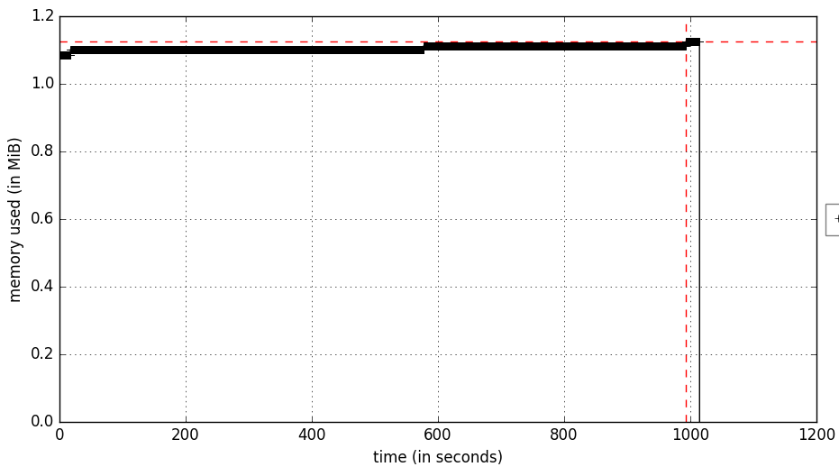
Pipeline Run Time
Serial pipeline single core/thread
MacBook Pro
Bs-seq: 1M reads from 5Mb Region of Chr1
Total Memory: ~1.1Gb
Run Time: 1000 seconds
17 minutes
Full Genome
Total Memory: ~11Gb RAM
Run Time: ~12 Hours
depending on #reads
bismark align
bismark extract
Russell S. Hamilton rsh46@cam.ac.uk ::: darogan@gmail.com ::: @drrshamilton 18

Slide 19
NGS Pipelines
Processing a large number of samples in a consistent, documented and reproducible manner
Optimise CPU usage with queuing system GRIDengine, SLURM etc
Pipelines can be custom bash scripts, Docker containers or specific pipeline tools.
Exact versions and command line options should be recorded in log files.
http://clusterflow.io
Single command:
$ cf --genome GRCh38 bismark_pipeline *.fa.gz
Pipeline outline:
#fastqc
#trim_galore
#bismark_align
#bismark_deduplicate
#samtools_sort coord
#preseq_lc_extrap
#preseq_bound_pop
#qualimap_bamqc
#picard_insert_size_metrics
#featureCounts
#bismark_methXtract
#bismark_report
>bismark_summary_report
>multiqc
Russell S. Hamilton rsh46@cam.ac.uk ::: darogan@gmail.com ::: @drrshamilton 19

Slide 20
Pipeline
Data Preparation
Generate Read Data
Reference Genome Preparation
Pre-alignment QC
Alignment & Meth Extract
Post-alignment QC
FastQC
bismark align
samtools sort
trim_galore
bismark deduplicate
picard
bismark meth extract
preseq
qualimap
Summarise
multiqc
Russell S. Hamilton rsh46@cam.ac.uk ::: darogan@gmail.com ::: @drrshamilton 20

Slide 21
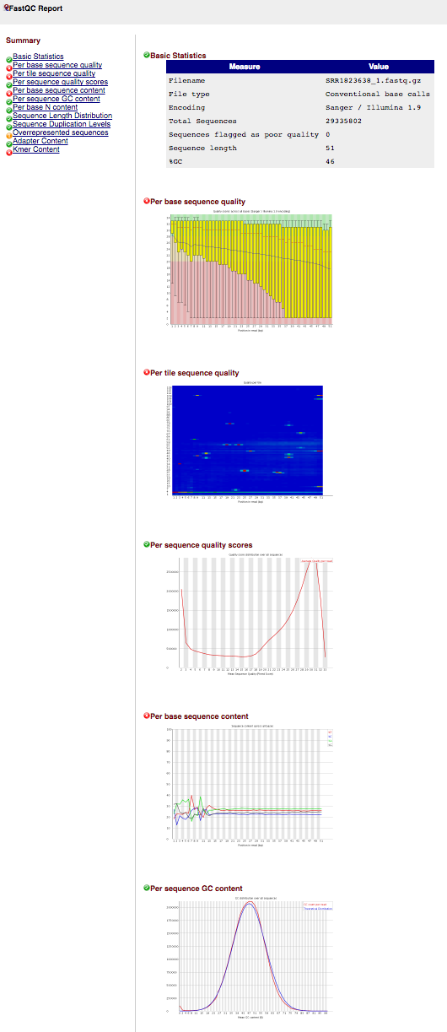
FastQC
FastQC A quality control tool for high throughput sequence data
Version 0.11.5
Download http://www.bioinformatics.babraham.ac.uk/projects/fastqc/
Terminal:
$ fastqc –q mkbs_sim_1000000_0.25_1.fastq.gz
$ firefox mkbs_sim_1000000_0.25_1_fastqc.html
$ fastqc –q mkbs_sim_1000000_0.25_2.fastq.gz
$ firefox mkbs_sim_1000000_0.25_1_fastqc.html
Output:
HTML Reports Archive of data/images
mkbs_sim_1000000_0.25_1_fastqc.html mkbs_sim_1000000_0.25_1_1_fastqc.zip
mkbs_sim_1000000_0.25_2_fastqc.html mkbs_sim_1000000_0.25_2_fastqc.zip
Read 1
Read 2
Bioinformatics Top Tip:
Simon Andrews’ https://sequencing.qcfail.com/
Russell S. Hamilton rsh46@cam.ac.uk ::: darogan@gmail.com ::: @drrshamilton 21

Slide 22
trim_galore
trim_galore A wrapper tool around Cutadapt to consistently apply quality and adapter trimming to FastQ files
Version 0.4.1
Download http://www.bioinformatics.babraham.ac.uk/projects/trim_galore/
Treat as paired-end
Compress output
Quality score threshold
Terminal:
$ trim_galore --paired --gzip -q 20 \
mkbs_sim_1000000_0.25_1.fastq.gz mkbs_sim_1000000_0.25_1.fastq.gz
Output:
Trimmed Fastq files
mkbs_sim_1000000_0.25_1_val_1.fq.gz
mkbs_sim_1000000_0.25_2_val_2.fq.gz
Trimming report files
mkbs_sim_1000000_0.25_1.fastq.gz_trimming_report.txt
mkbs_sim_1000000_0.25_2.fastq.gz_trimming_report.txt
Read 1
Read 2
Russell S. Hamilton rsh46@cam.ac.uk ::: darogan@gmail.com ::: @drrshamilton 22

Slide 23
Pipeline
Data Preparation
Generate Read Data
Reference Genome Preparation
Pre-alignment QC
Alignment & Meth Extract
Post-alignment QC
FastQC
bismark align
samtools sort
trim_galore
bismark deduplicate
picard
bismark meth extract
preseq
qualimap
Summarise
multiqc
Russell S. Hamilton rsh46@cam.ac.uk ::: darogan@gmail.com ::: @drrshamilton 23

Slide 24
Bismark alignment
bismark A tool to map bisulfite converted sequence reads and determine cytosine methylation states
Version 0.16.3
Download http://www.bioinformatics.babraham.ac.uk/projects/bismark/
Terminal:
$ bismark --bowtie2 NGSchool_GRCh38_Chr1_region \
-1 mkbs_sim_1000000_0.25_1_val_1.fq.gz -2 mkbs_sim_1000000_0.25_2_val_2.fq.gz
Output:
mkbs_sim_1000000_0.25_1_val_1_bismark_bt2_PE_report.txt
mkbs_sim_1000000_0.25_1_val_1_bismark_bt2_pe.bam
Use bowtie2 (>50nt)
Reference Genome Location
Read 1
Read 2
OSX Trouble Shooting:
Some versions of bismark use zcat
Fix by using sed to replace zcat with gunzip -c
Russell S. Hamilton rsh46@cam.ac.uk ::: darogan@gmail.com ::: @drrshamilton 24

Slide 25
Bismark Deduplicate
bismark A tool to map bisulfite converted sequence reads and determine cytosine methylation states
Version 0.16.3
Download http://www.bioinformatics.babraham.ac.uk/projects/bismark/
Output BAM format
Bismark alignment BAM file
Paired-end
Terminal:
$ deduplicate_bismark -p –bam mkbs_sim_1000000_0.25_1_val_1_bismark_bt2_pe.bam
Output:
mkbs_sim_1000000_0.25_1_val_1_bismark_bt2_pe.deduplicated.bam
mkbs_sim_1000000_0.25_1_val_1_bismark_bt2_pe.deduplication_report.txt
Russell S. Hamilton rsh46@cam.ac.uk ::: darogan@gmail.com ::: @drrshamilton 25

Slide 26
Bismark methylation extractor
bismark A tool to map bisulfite converted sequence reads and determine cytosine methylation states
Version 0.16.3
Download http://www.bioinformatics.babraham.ac.uk/projects/bismark/
Ignore first 5’ bp Read 2
Ignore the last 2 3’ bp Read 2
Terminal:
$ bismark_methylation_extractor --ignore_r2 1 --ignore_3prime_r2 2 \
--bedGraph --gzip -p --no_overlap --report \
mkbs_sim_1000000_0.25_1_val_1_bismark_bt2_pe.deduplicated.bam
Output:
mkbs_sim_1000000_0.25_1_val_1_bismark_bt2_pe.deduplicated.M-bias.txt
mkbs_sim_1000000_0.25_1_val_1_bismark_bt2_pe.deduplicated.M-bias_R1.png
mkbs_sim_1000000_0.25_1_val_1_bismark_bt2_pe.deduplicated.M-bias_R2.png
mkbs_sim_1000000_0.25_1_val_1_bismark_bt2_pe.deduplicated.bedGraph.gz
mkbs_sim_1000000_0.25_1_val_1_bismark_bt2_pe.deduplicated.bismark.cov.gz
mkbs_sim_1000000_0.25_1_val_1_bismark_bt2_pe.deduplicated_splitting_report.txt
Cytosine Methylation
Compress
PE
Ignore PE overlap
Final summary
Bismark deduplicated BAM file
Russell S. Hamilton rsh46@cam.ac.uk ::: darogan@gmail.com ::: @drrshamilton 26

Slide 27
Pipeline
Data Preparation
Generate Read Data
Reference Genome Preparation
Pre-alignment QC
Alignment & Meth Extract
Post-alignment QC
FastQC
bismark align
samtools sort
trim_galore
bismark deduplicate
picard
bismark meth extract
preseq
qualimap
Summarise
multiqc
Russell S. Hamilton rsh46@cam.ac.uk ::: darogan@gmail.com ::: @drrshamilton 27

Slide 28
Samtools sort
samtools Utilities for the Sequence Alignment/Map (SAM) format
Version 1.3.1
Download http://www.htslib.org/download
Terminal:
$ samtools sort -o mkbs_sim_1000000_0.25_1_val_1_bismark_bt2_pe.srtd.bam \
mkbs_sim_1000000_0.25_1_val_1_bismark_bt2_pe.bam
Output:
mkbs_sim_1000000_0.25_1_val_1_bismark_bt2_pe.srtd.bam
Output coordinate sorted BAM file
Input name sorted BAM file
Russell S. Hamilton rsh46@cam.ac.uk ::: darogan@gmail.com ::: @drrshamilton 28

Slide 29
Samtools index
samtools Utilities for the Sequence Alignment/Map (SAM) format
Version 1.3.1
Download http://www.htslib.org/download
Terminal:
$ samtools index mkbs_sim_1000000_0.25_1_val_1_bismark_bt2_pe.srtd.bam
Output:
mkbs_sim_1000000_0.25_1_val_1_bismark_bt2_pe.srtd.bam.bai
Input name sorted BAM file
Russell S. Hamilton rsh46@cam.ac.uk ::: darogan@gmail.com ::: @drrshamilton 29

Slide 30
Picard insert size metrics
Picard Tools for manipulating high-throughput sequencing (HTS) data
Version 2.2.4+
Download http://broadinstitute.github.io/picard/
Terminal:
$ java -jar /usr/local/picard-tools-2.2.4/picard.jar CollectInsertSizeMetrics \
INPUT=mkbs_sim_1000000_0.25_1_val_1_bismark_bt2_pe.srtd.bam
OUTPUT=mkbs_sim_1000000_0.25_1_val_1_bismark_bt2_pe.srtd_picard_insert_size_metrics.txt
HISTOGRAM_FILE=mkbs_sim_1000000_0.25_1_val_1_bismark_bt2_pe.srtd_picard_insert_size_plot.pdf
METRIC_ACCUMULATION_LEVEL=ALL_READS
Output:
mkbs_sim_1000000_0.25_1_val_1_bismark_bt2_pe.srtd_picard_insert_size_metrics.txt
mkbs_sim_1000000_0.25_1_val_1_bismark_bt2_pe.srtd_picard_insert_size_plot.pdf
Location of Picard Jar File
Picard Tool to run
Input coord sorted BAM file
Outputs
Look at all reads
Usually a distribution
Due to simulated data
Russell S. Hamilton rsh46@cam.ac.uk ::: darogan@gmail.com ::: @drrshamilton 30

Slide 31
Preseq
preseq Predicting and estimating the complexity of a genomic sequencing library
Version 2.0
Download http://smithlabresearch.org/software/preseq/
Terminal:
predict the yield for future experiments
$ preseq lc_extrap -B -P -o mkbs_sim_1000000_0.25_1_val_1_bismark_bt2_pe.srtd.preseq.lc_extrap.tsv \
mkbs_sim_1000000_0.25_1_val_1_bismark_bt2_pe.srtd.bam
Output:
mkbs_sim_1000000_0.25_1_val_1_bismark_bt2_pe.srtd.preseq.lc_extrap.tsv
Input BAM
Paired end
Output tab separated values
Input name sorted BAM file
Russell S. Hamilton rsh46@cam.ac.uk ::: darogan@gmail.com ::: @drrshamilton 31

Slide 32
Qualimap bamqc
QualiMap Evaluating next generation sequencing alignment data
Version 2.2
Download http://qualimap.bioinfo.cipf.es/
Terminal:
$ JAVA_OPTS="-Djava.awt.headless=true”
$ qualimap bamqc -sd -c -bam mkbs_sim_1000000_0.25_1_val_1_bismark_bt2_pe.srtd.bam
Output:
mkbs_sim_1000000_0.25_1_val_1_bismark_bt2_pe.srtd_stats/
└── qualimapReport.html
Run as command line (useful for HPC!)
Paint chromosome limits inside charts
Input name sorted BAM file
skip duplicated alignments
Input BAM format
Russell S. Hamilton rsh46@cam.ac.uk ::: darogan@gmail.com ::: @drrshamilton 32

Slide 33
Pipeline
Data Preparation
Generate Read Data
Reference Genome Preparation
Pre-alignment QC
Alignment & Meth Extract
Post-alignment QC
FastQC
bismark align
samtools sort
trim_galore
bismark deduplicate
picard
bismark meth extract
preseq
qualimap
Summarise
multiqc
Russell S. Hamilton rsh46@cam.ac.uk ::: darogan@gmail.com ::: @drrshamilton 33

Slide 34
MultiQC
MultiQC Aggregate results from bioinformatics analyses across many samples into a single report
Version 0.8dev
Download http://multiqc.info/
Terminal:
$ multiqc -f -i ”NGSchool.eu" --filename "NGSchool.eu.multiqc_report.html" .
$ NGSchool.eu.multiqc_report.html
Output:
HTML Report
NGSchool.eu.multiqc_report.html
NGSchool.eu.multiqc_report_data
A title for your report
Output filename
Overwrite existing report
“.” Is a special Linux symbol which means the current directory
Russell S. Hamilton rsh46@cam.ac.uk ::: darogan@gmail.com ::: @drrshamilton 34

Slide 35
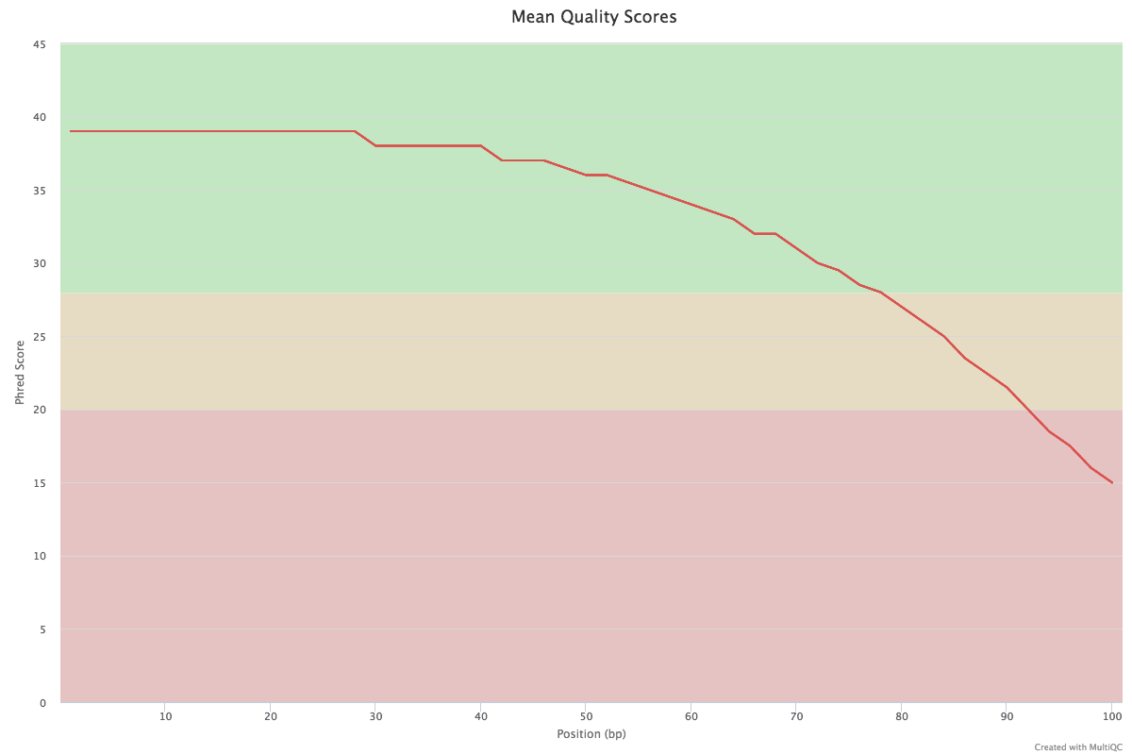
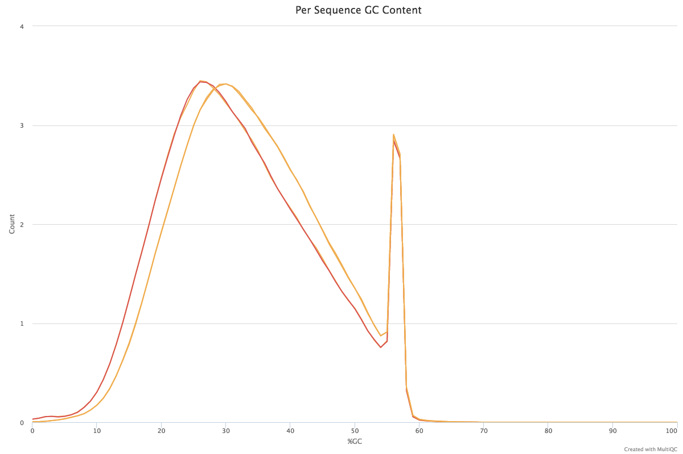
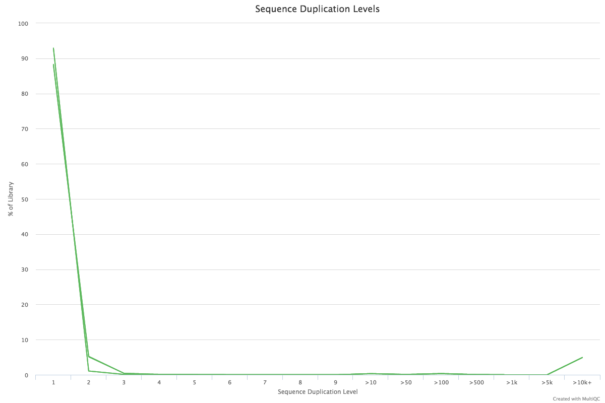
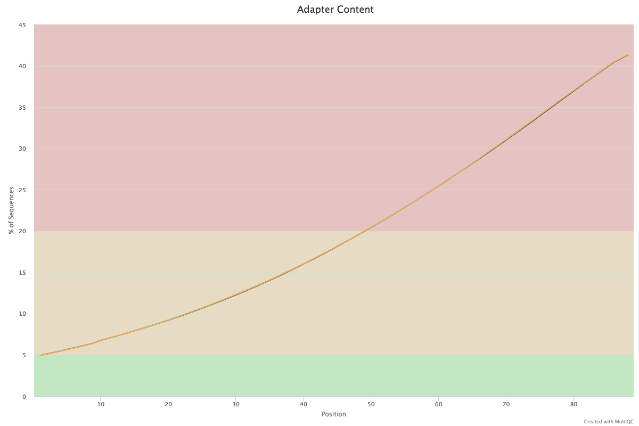
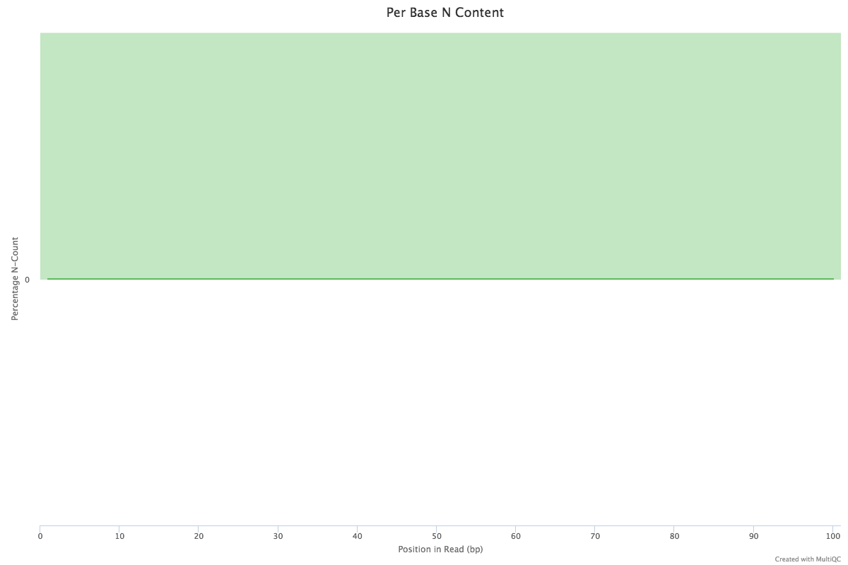
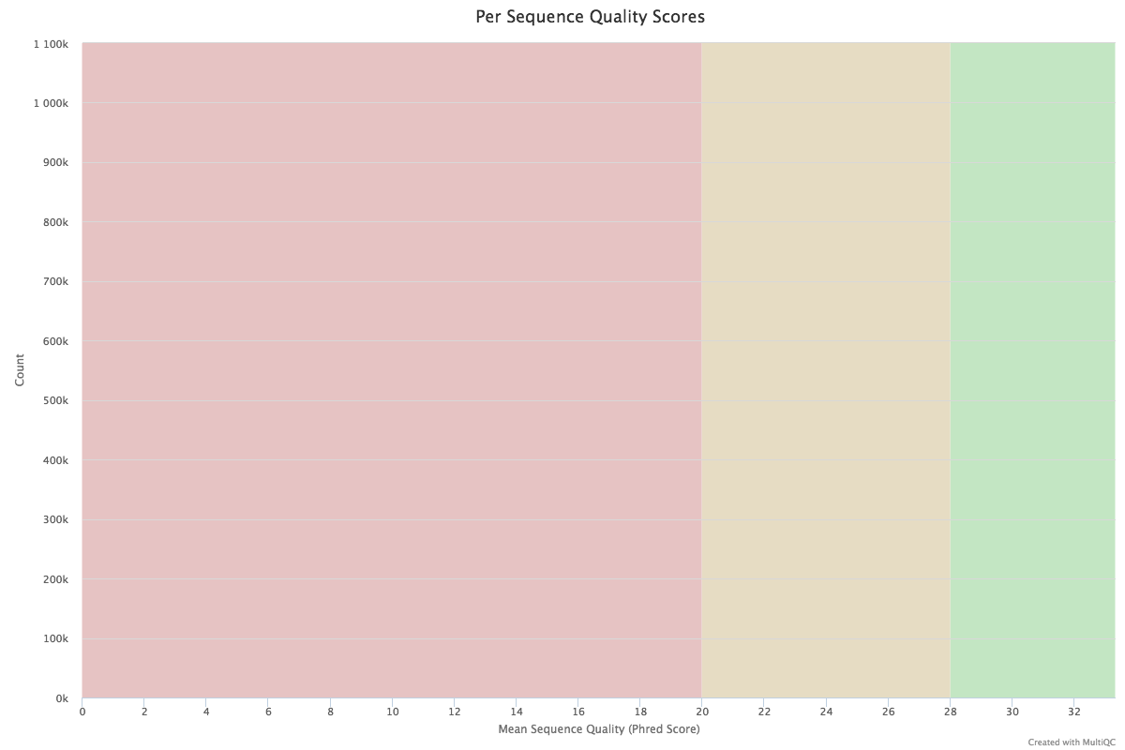
MultiQC ::: FastQC
Includes mkbs & oxbs
Russell S. Hamilton rsh46@cam.ac.uk ::: darogan@gmail.com ::: @drrshamilton 35

Slide 36
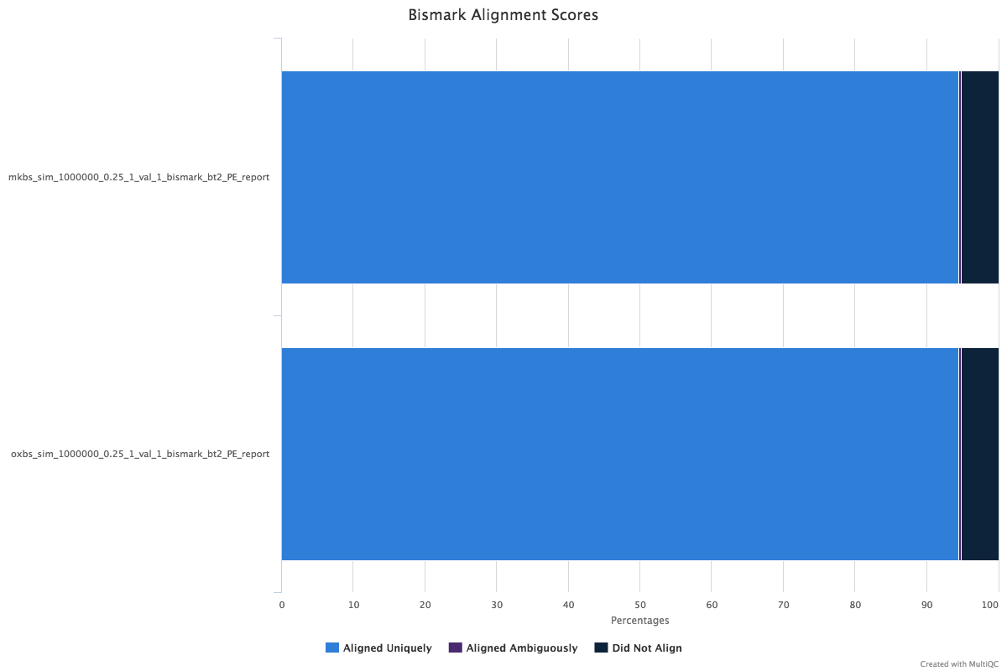
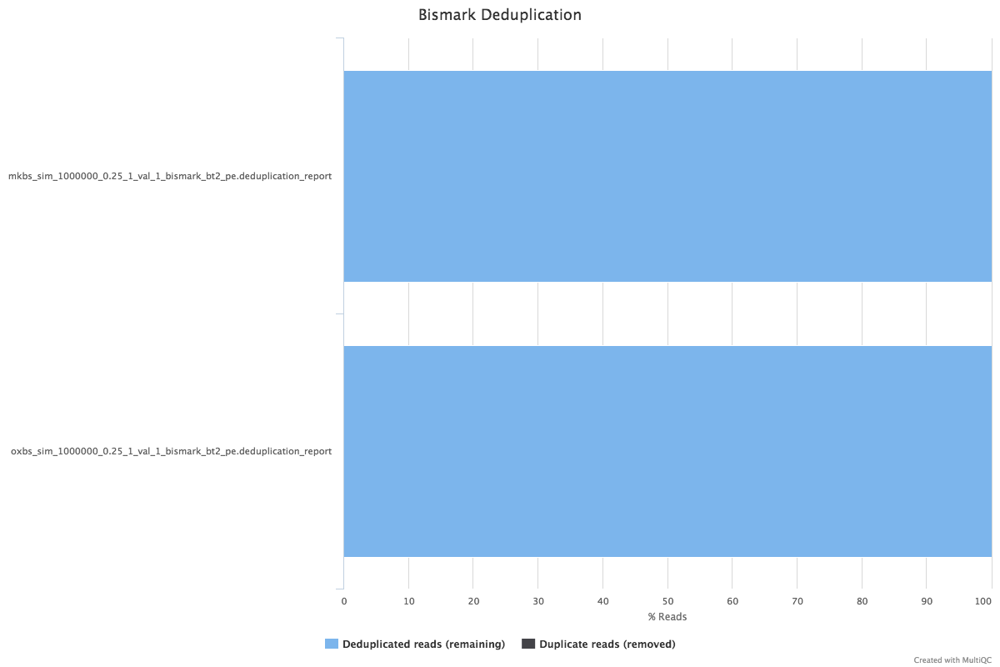
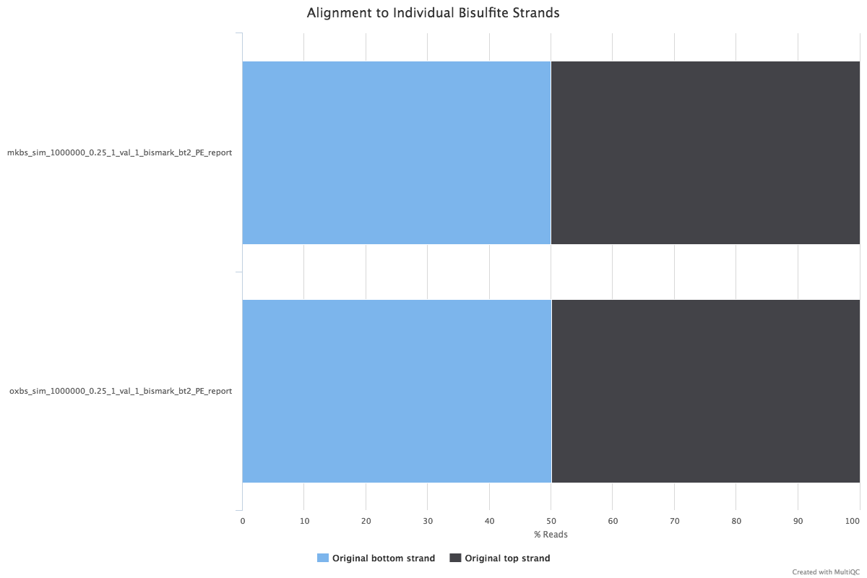
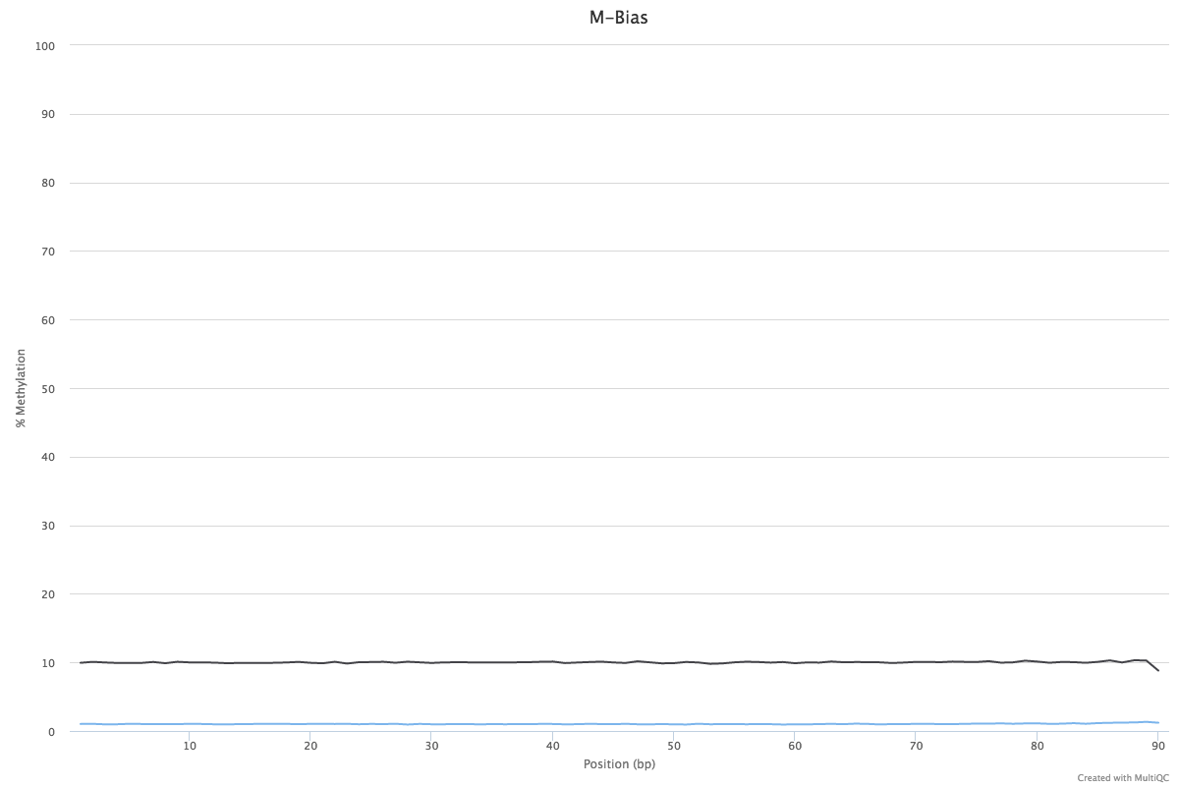
MultiQC ::: Bismark
Includes mkbs & oxbs
Russell S. Hamilton rsh46@cam.ac.uk ::: darogan@gmail.com ::: @drrshamilton 36

Slide 37
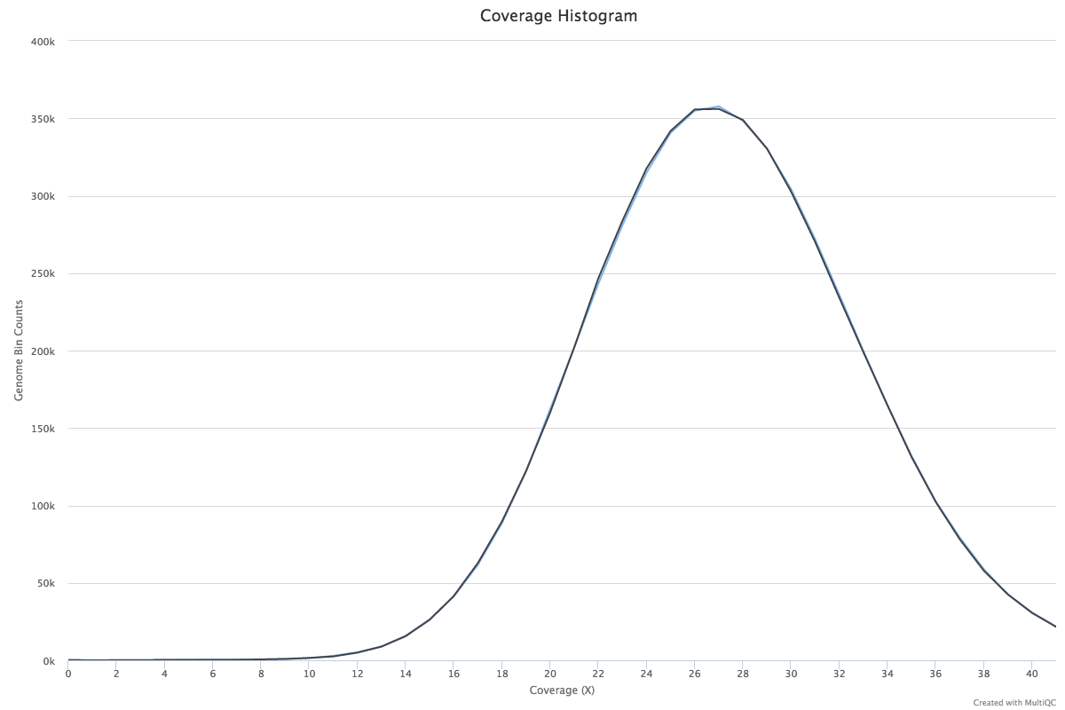
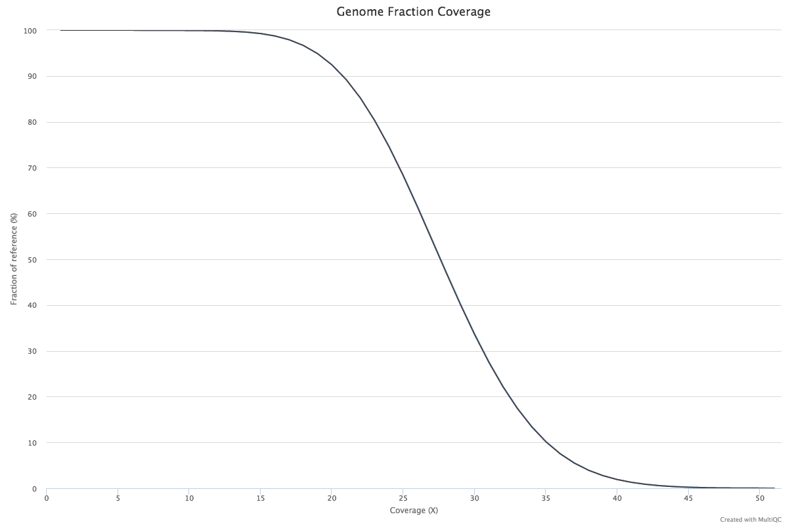
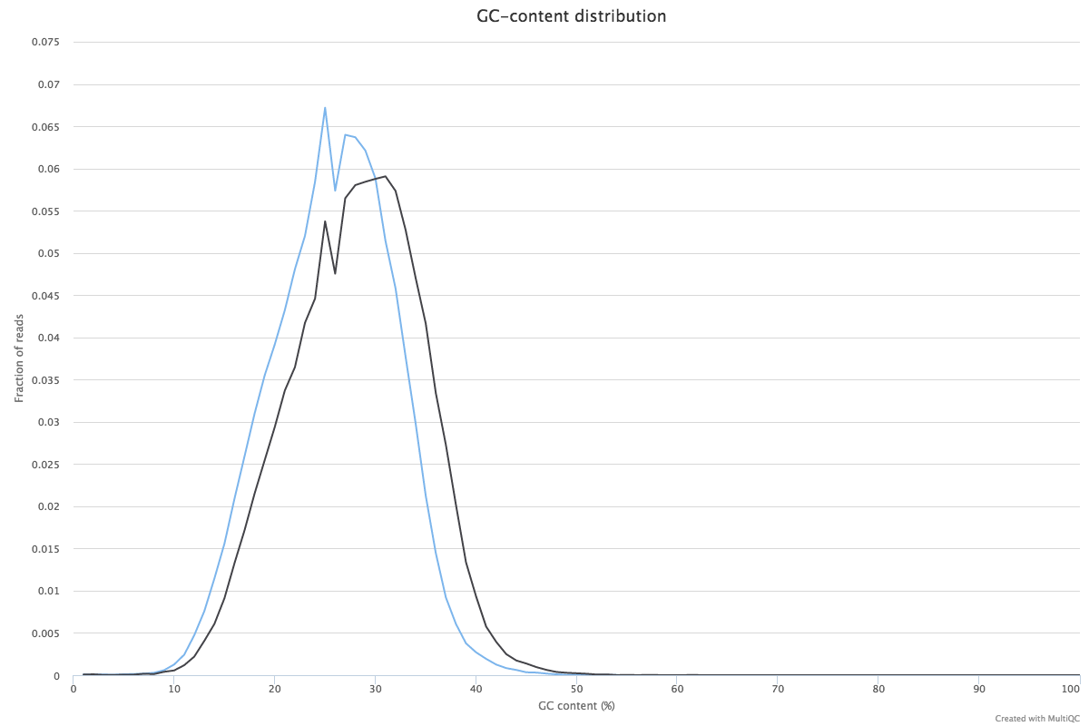
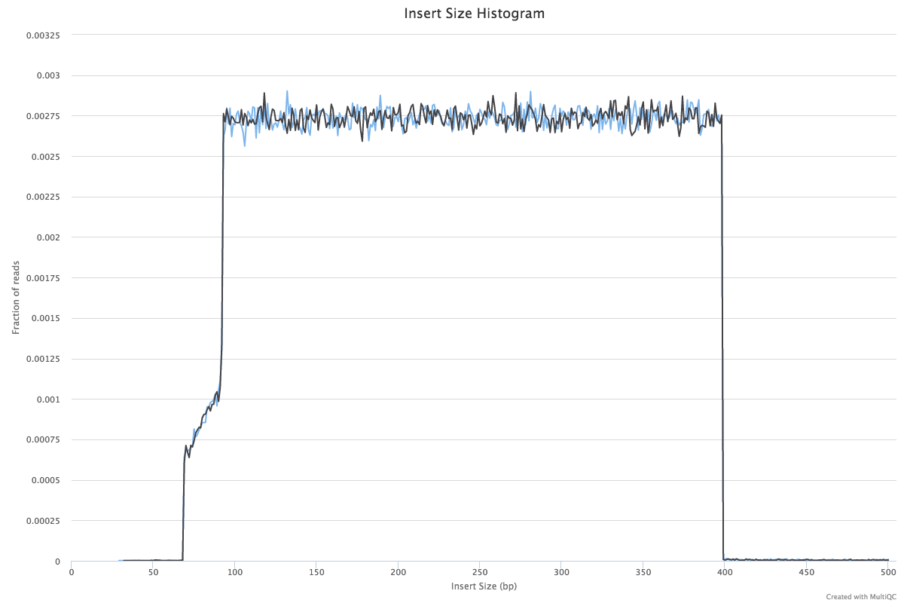
MultiQC ::: Qualimap
Includes mkbs & oxbs
Reads simulated for ~30X coverage
After trimming and alignment
Average 27X
~35% genome covered at 30X
mkbs / oxbs difference = hmC
(In oxbs hmC oxidised to fC sequences as C, therefore more C expected in oxbs)
Russell S. Hamilton rsh46@cam.ac.uk ::: darogan@gmail.com ::: @drrshamilton 37

Slide 38
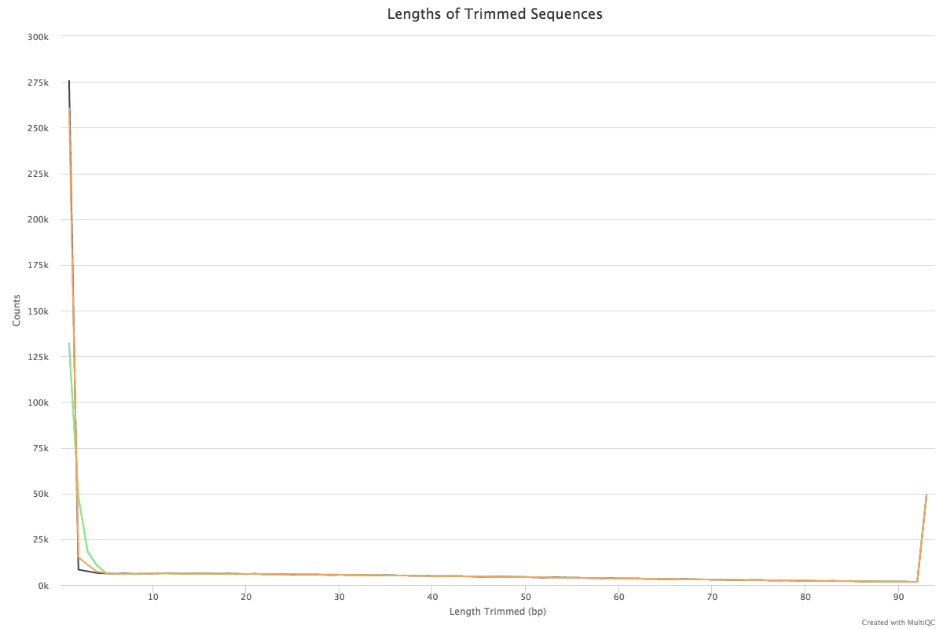
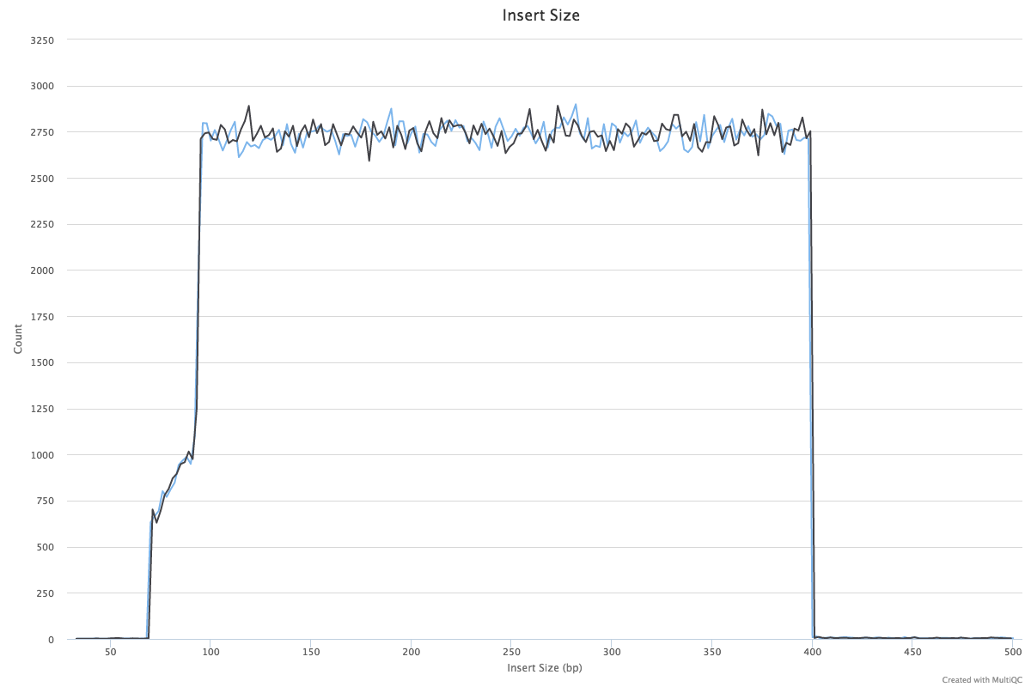
MultiQC ::: Cutadapt & Picard
Picard Insert Size Metrics
Cutadapt
Russell S. Hamilton rsh46@cam.ac.uk ::: darogan@gmail.com ::: @drrshamilton 38

Slide 39
Methyl-Kit
Methyl-Kit R package for DNA methylation analysis
Version v0.99.2
Download https://github.com/al2na/methylKit
Terminal:
$ Rscript ngschool.methylkit.R
Output:
Plots NGSchool.eu.methylkit.PCASamples.ward_corr_plot.pdf
NGSchool.eu.methylkit.CorrelationPlot.pdf
NGSchool.eu.methylkit.PCASamples.screeplot.pdf
NGSchool.eu.methylkit.PCASamples.pdf
NGSchool.eu.methylkit.diffMethPerChr.pdf
Tables NGSchool.eu.methylkit.hyper_methylated.tsv
NGSchool.eu.methylkit.DiffMeth.tsv
NGSchool.eu.methylkit.hypo_methylated.tsv
NGSchool.eu.methylkit.differentialy_methylated.tsv
Custom R-script
Russell S. Hamilton rsh46@cam.ac.uk ::: darogan@gmail.com ::: @drrshamilton 39

Slide 40
Methyl-Kit
Note: This is simulated data so biologically meaningless!
Russell S. Hamilton rsh46@cam.ac.uk ::: darogan@gmail.com ::: @drrshamilton 40

Slide 41
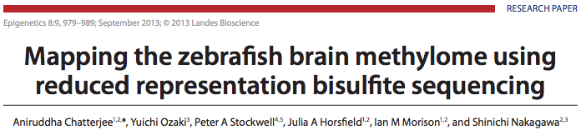
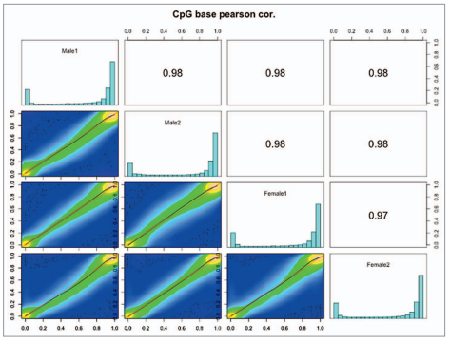
MethylKit ::: Example Data
Russell S. Hamilton rsh46@cam.ac.uk ::: darogan@gmail.com ::: @drrshamilton 41

Slide 42
Comparing Samples / DMR Calling
Top 5 by location out of 122K [NGSchool.eu.methylkit.hypo_methylated.txt]
Top 5 by location out of 8K [ NGSchool.eu.methylkit.hyper_methylated.txt]
Note: This is simulated data so biologically meaningless!
Russell S. Hamilton rsh46@cam.ac.uk ::: darogan@gmail.com ::: @drrshamilton 42

Slide 43
IGV
Load the reference genome (only the 5Mb region)
IGV
└── Genomes
└── Create .genome File...
└── Select
NGSchool_GRCh38_Chr1_region/Homo_sapiens.GRCh38.dna.chromosome.1.region30000000-5000000.fa
Load the aligned reads BAM files:
IGV
└── File
└── Load From File...
SimulatedData /mkbs_sim_1000000_0.25_1_val_1_bismark_bt2_pe.srtd.bam
SimulatedData /oxbs_sim_1000000_0.25_1_val_1_bismark_bt2_pe.srtd.bam
Russell S. Hamilton rsh46@cam.ac.uk ::: darogan@gmail.com ::: @drrshamilton 43

Slide 44
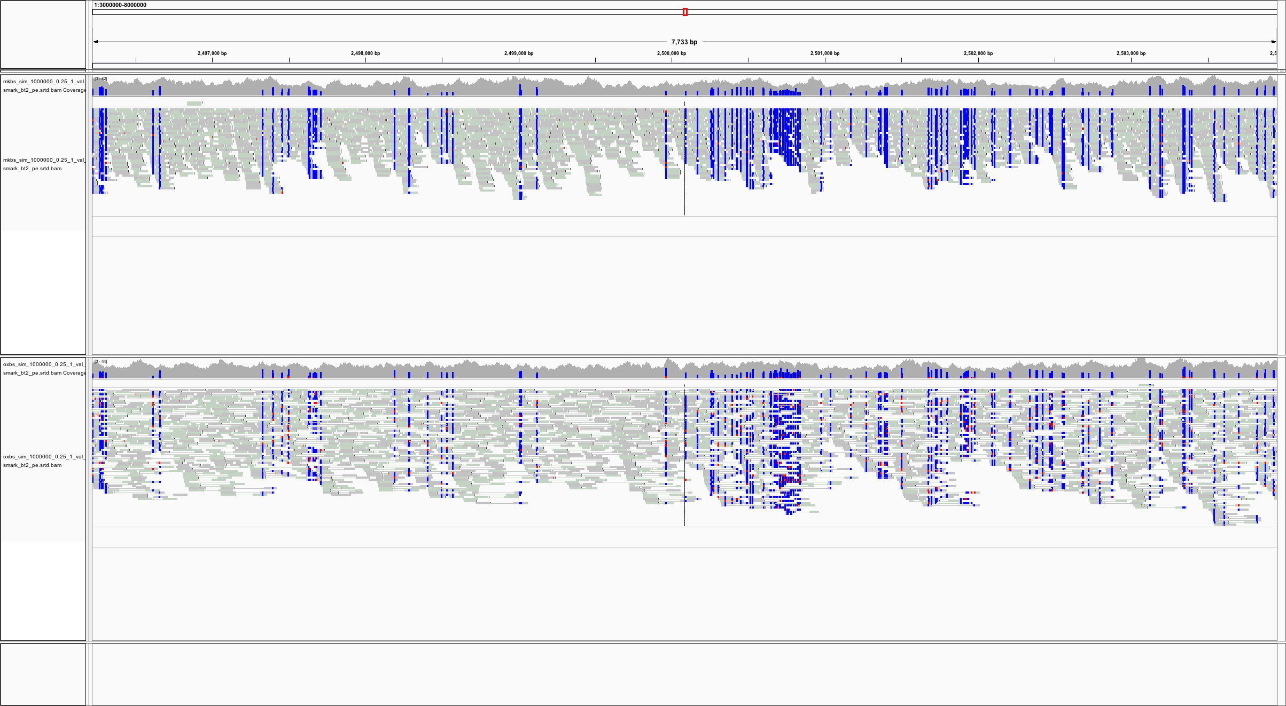
IGV
mkbs
oxbs
Russell S. Hamilton rsh46@cam.ac.uk ::: darogan@gmail.com ::: @drrshamilton 44

Slide 45
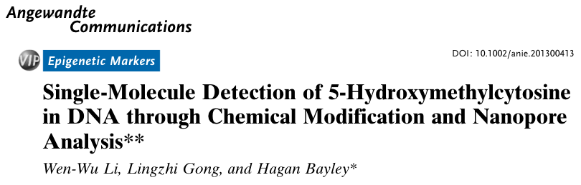
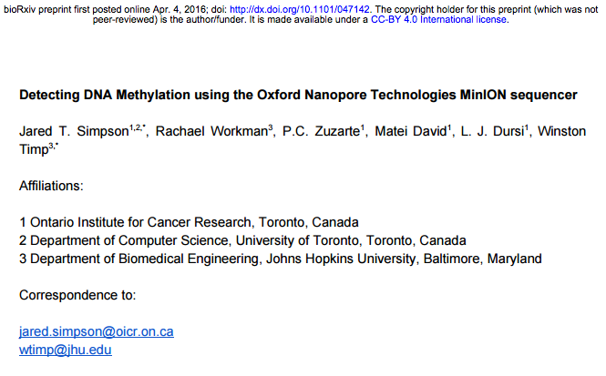
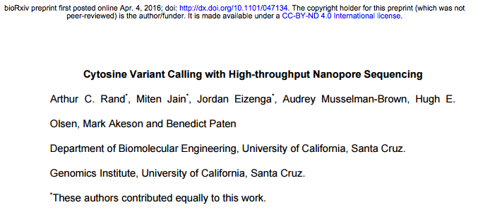
Future of Single Base Resolution Methylation
Oxford Nanopore Technologies
Russell S. Hamilton rsh46@cam.ac.uk ::: darogan@gmail.com ::: @drrshamilton 45

Slide 46
Dr Russell S. Hamilton
Email: rsh46@cam.ac.uk
Web: http://www.trophoblast.cam.ac.uk/directory/Russell-Hamilton
License: Attribution-Non Commercial-Share Alike CC BY-NC-SA ( https://creativecommons.org/licenses/by-nc-sa/ )
Attribution: You must give appropriate credit, provide a link to the license, and indicate if changes were made.
You may do so in any reasonable manner, but not in any way that suggests the licensor endorses you or your use.
NonCommercial: You may not use the material for commercial purposes.
ShareAlike: If you remix, transform, or build upon the material, you must distribute your contributions under the same license as the original.

